Slide 1
Talking About Sports…

Slide 2
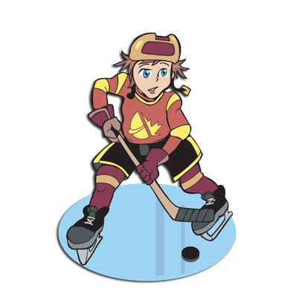
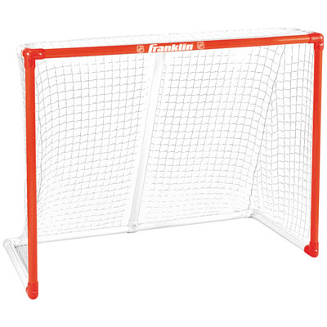
Hockey
Action verb: To shoot
Accessories needed:
Ice rink
Helmet
Hockey stick
Puck
Skate
Hockey net

Slide 3
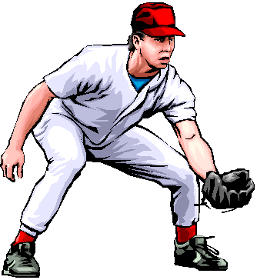
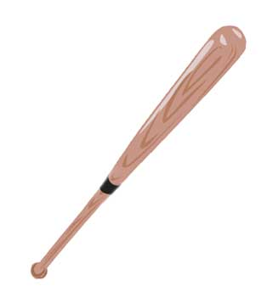
Baseball
Action verb: To catch
Accessories needed:
Cap
Mitt
Baseball
Baseball bat

Slide 4
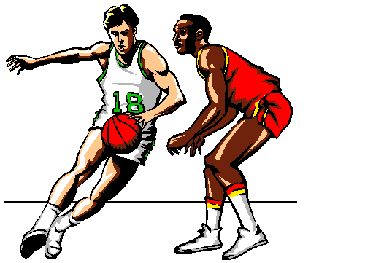
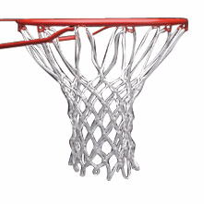
Basketball
Action verb: To throw
Accessories needed:
Uniforms
Basketball
Basketball net

Slide 5
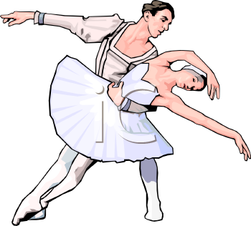
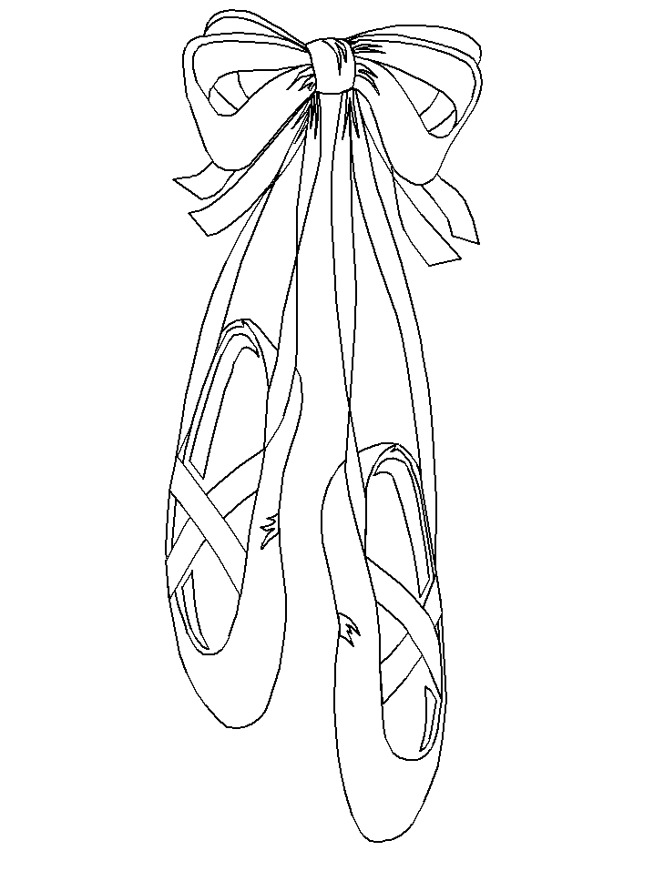
Dance
Action verb: To dance
Accessories needed:
Ballet costume
Ballet shoes

Slide 6
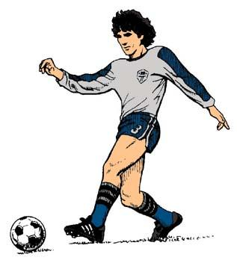
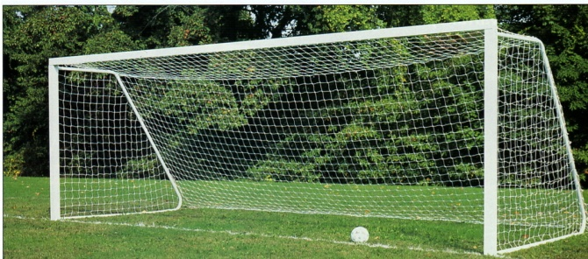
Soccer (European football)
Action verb: To kick
Accessories needed:
Soccer ball
Soccer spikes
Soccer goal (soccer net)

Slide 7
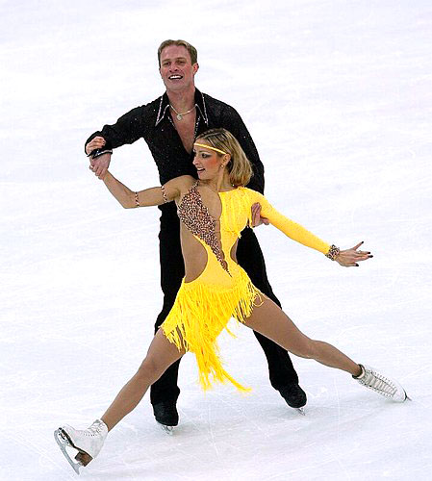
Figure skating
Action verb: To skate
Accessories needed:
Ice rink
Glamour outfit
Skate

Slide 8
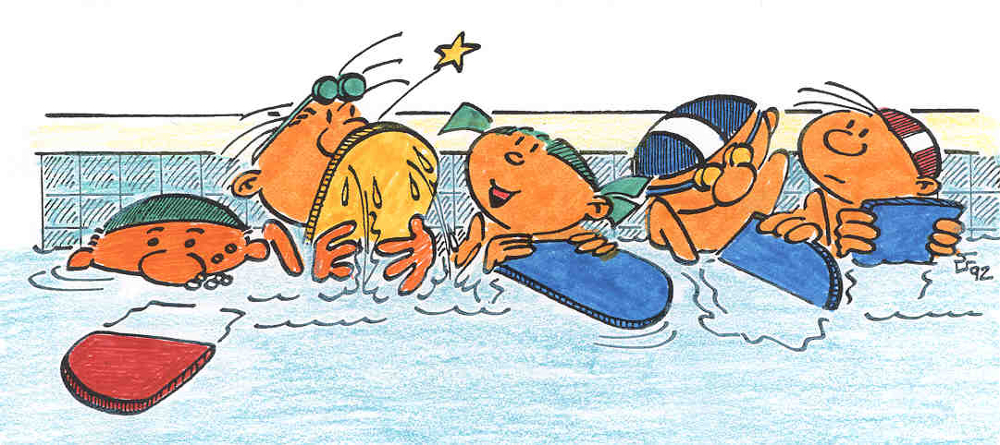
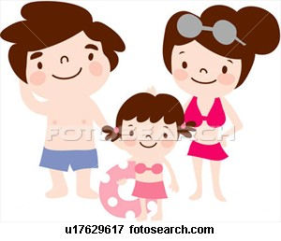
Swimming
Accessories needed:
Swimming hat
Goggles
Swimming board
Pool
Swimsuit
Action verb: To swim

Slide 9
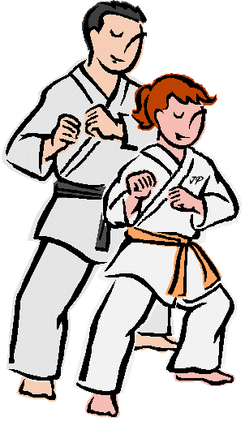
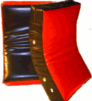
Karate
Verb: To do karate OR to practice karate
Accessories needed:
Martial Art Costume
Belt
Kicking shield

Slide 10
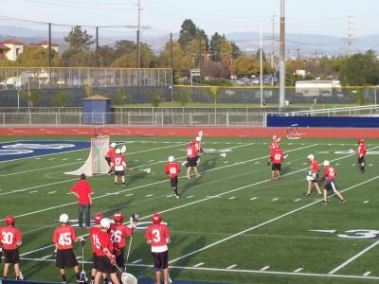
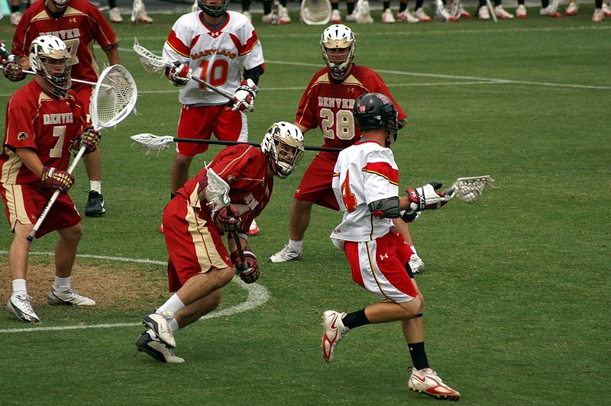
Lacrosse
Action verb: to catch and to hold
Accessories needed:
Field
Lacrosse stick
Helmet
Gloves

Slide 11
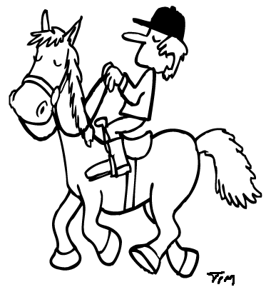
Horseback riding
Action verb: To ride
Accessories needed:
Helmet
Saddle
Stirrup
Horse

