Slide 1
PowerPoint Game – Project #1
The purpose of this game is to help students acquire the vocabulary of sea’s animals
Targeted audience: Elementary level cycle 1
What the students will have to do?
The computer will ask a question
Students will have to click on the right animal
If the answer is good, it will be directed to another page with another question
Otherwise, they will have to go back to the previous question
Joannie Charette and Marc-Antoine Lamothe

Slide 2
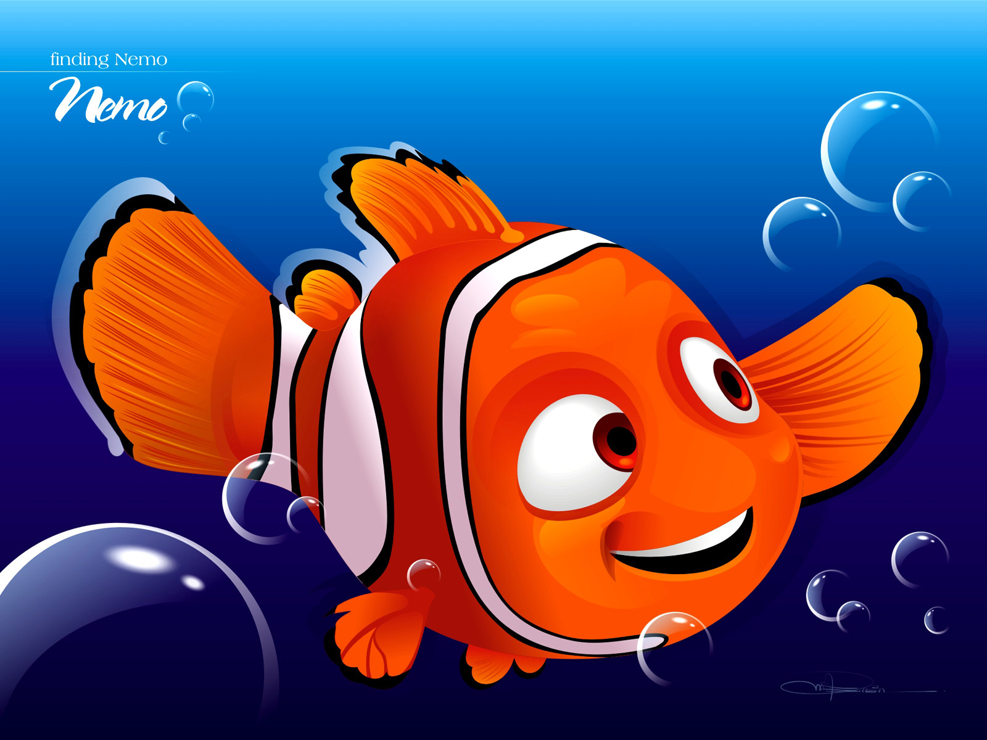
Under the Sea

Slide 3
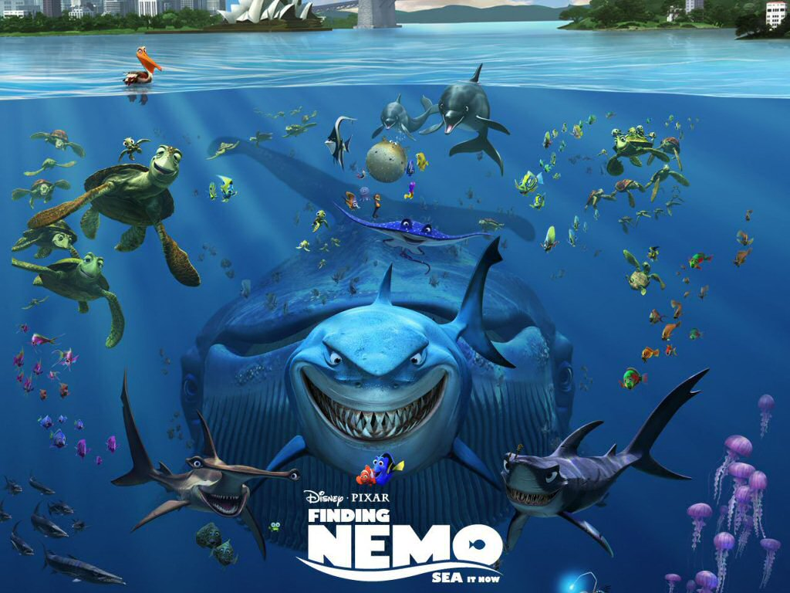
Question #1: Where are the turtles?

Slide 4
Well Done!
Continue

Slide 5
Oops! Try Again!
Try Again

Slide 6
Question #2: Where are the dolphins?

Slide 7
Well Done!
Continue

Slide 8
Oops! Try Again!
Try Again

Slide 9
Question #3: Where are the fishes?

Slide 10
Well Done!
Continue

Slide 11
Oops! Try Again!
Try Again

Slide 12
Question #4: Where are the jellyfishes?

Slide 13
Well Done!
Continue

Slide 14
Oops! Try Again!
Try Again

Slide 15
Question #5: Where is the shark?

Slide 16
Well Done!
Continue

Slide 17
Oops! Try Again!
Try Again

Slide 18
Question #6: Where is the manta ray?

Slide 19
Well Done!
Continue

Slide 20
Oops! Try Again!
Try Again

Slide 21
Question #7: Where is the pelican?

Slide 22
Well Done!
Continue

Slide 23
Oops! Try Again!
Try Again

Slide 24
Good Job!

